Slide 1
Optimization of Metasurfaces for Computational Imaging
Dean Hazineh | PhD Candidate Applied Physics
Advisors: Todd Zickler, Federico Capasso
CSE Oral Presentation
April 26, 2024
Notes:
Hello and thank you for having me. My name is Dean Hazineh and I will be giving a talk on the optimization of metasurfaces for computational imaging. I am a PhD student in the Applied Physics department, advised by Todd Zickler and Federico Capasso.

Slide 2
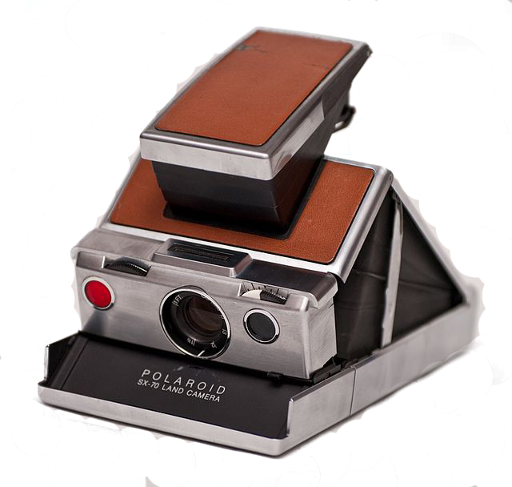
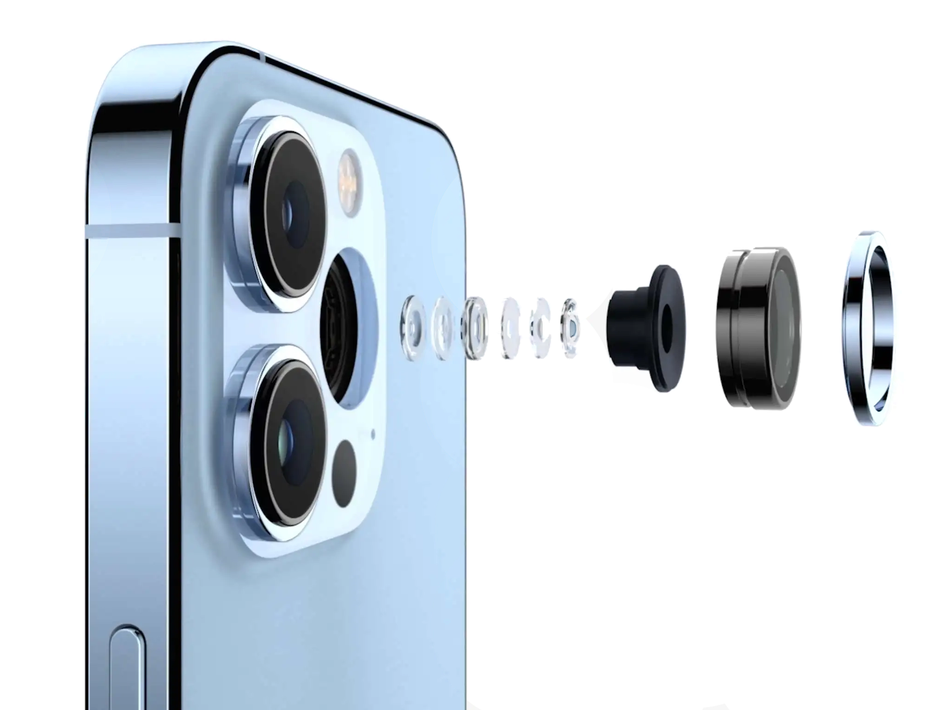
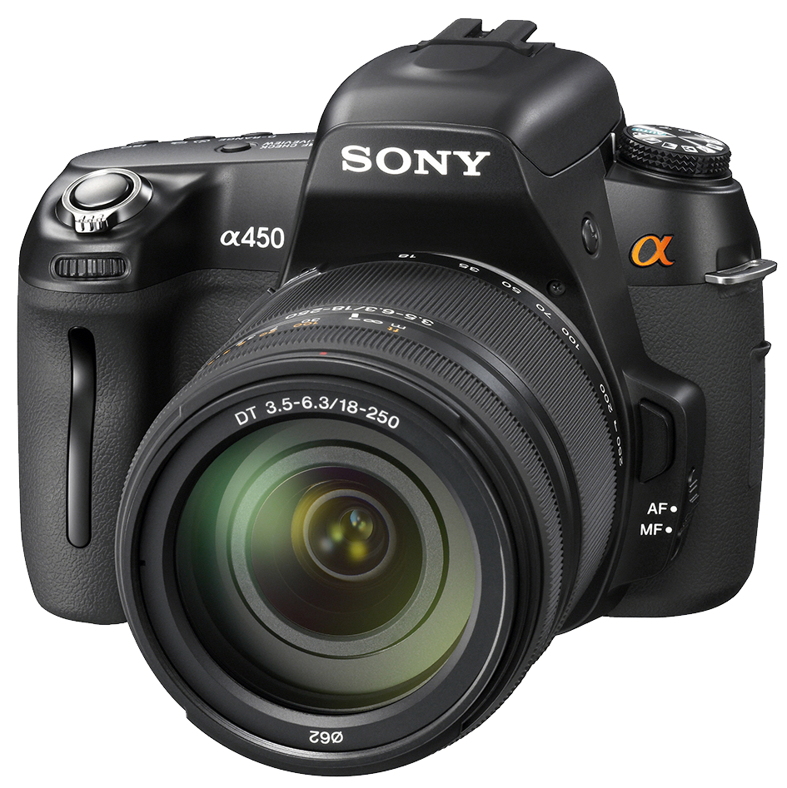
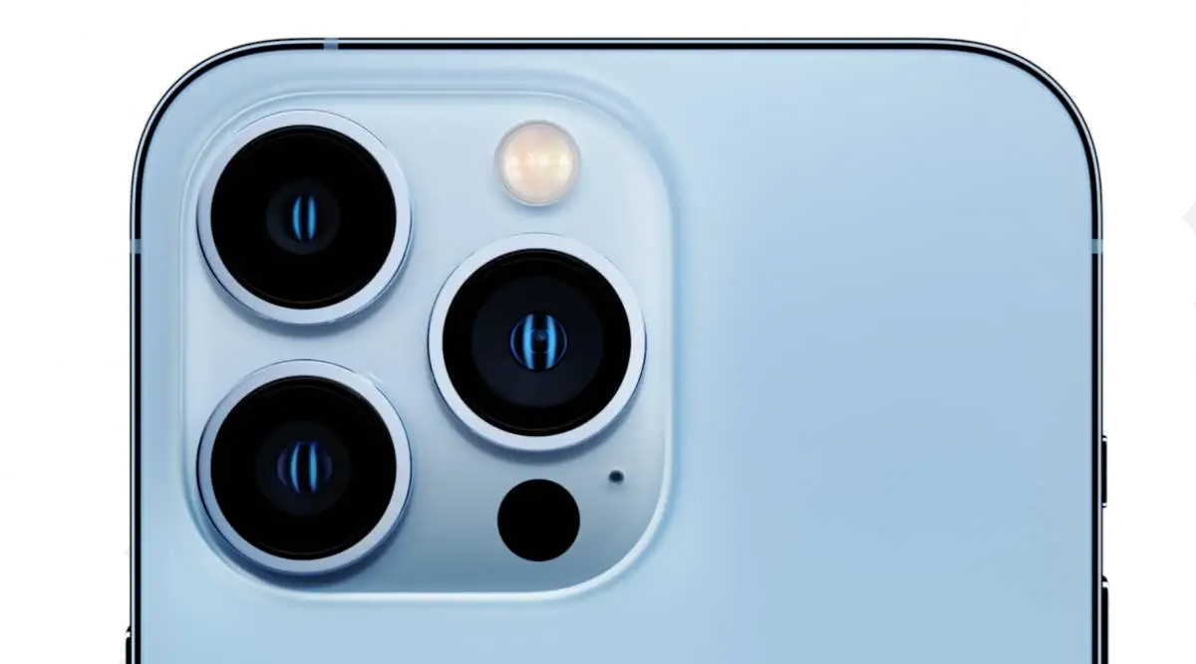
Conventional Imaging Systems
1940
2010
2020
1839: First photographic lens – modern cameras
1550: Images made w/ concave mirror & lenses
-500 (BC): Camera Obscura (Pinhole Camera)
Design principle of all conventional cameras is largely the same:
A single point in the scene should project to a single point on the photosensor
Captured measurements are undistorted projections of scene, close the final image
→ The design of computational imaging systems deviates from this idea
Notes:
Before we begin, I want to talk briefly about the design of conventional imaging systems. When I say a conventional camera, you probably think of one of these three things: An Iphone, A SONY DSLR, or maybe even a vintage polaroid instant camera
But it doesn’t matter which one comes to mind, because the design paradigm of all these cameras are largely the same:
Their operation is based on the idea that “A single point in the scene should project its light to a single point on the photosensor plane” like with raytracing.
Consequently the captured measurements are undistorted projections of a scene and are close to a final image that you would show a user, without much post-processing
And in fact if you look through the history of cameras, it has almost always been this way, dating back to the pinhole camera in 500 BC.
As we transition to computational imaging, its useful to note that the design of computational imaging systems deviate fundamentally from this idea.

Slide 3
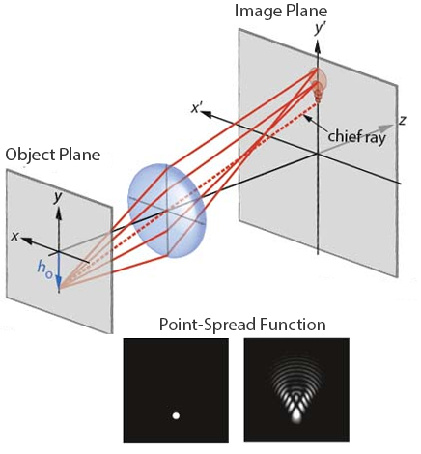
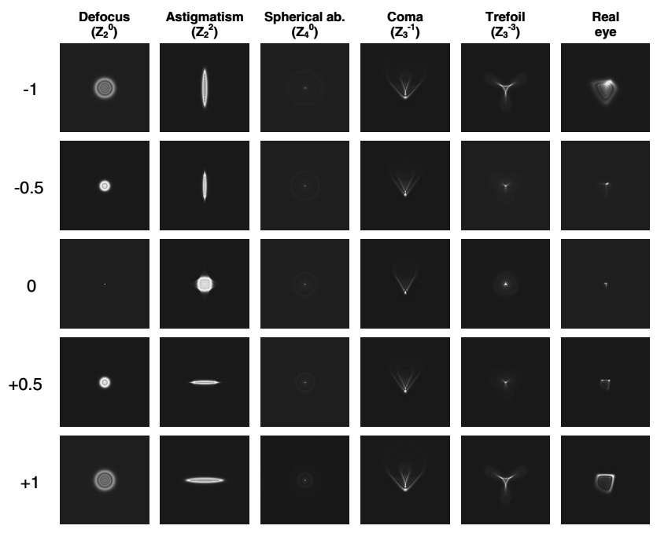
Centuries pursuit of the Ideal Lens
Scale of Aberration
Moving away from ideal focusing to structured point-spread functions enable better vision systems and cameras
How we engineer the point-spread function for computational imaging with a new type of lens, metasurfaces
[1] Effect_of_third-order_aberrations_on_dynamic_accommodation
[2] https://wiley-vch.e-bookshelf.de/products/reading-epub/product-id/5030654/title/Optical
Notes:
More formally, this description about the behavior of the camera is encapsulated in a quantity known as the point-spread function, essentially the impulse-response of the imaging system. It is computed by considering a single point-source radiating light at the object plane and measuring the intensity that it projects to in the image plane.
The centuries long pursuit of an ideal lens is that of a point-spread function that is just a delta function under all illumination scenarios. But there are a lot of ways you can deviate from this. Aberrations with nice mathematical forms or those that have been historically very common are given names like defocus, astigmatism, spherical aberration etc.
Underlying this talk is the basic idea that I will briefly try to convince you of otherwise you’ll have to accept it, that “moving away from ideal focusing to structured point-spread functions” like the ones shown above can actually enable better vision systems and cameras, specifically when paired with digital post-processing. And the heart of this talk is a discussion about how we engineer these point-spread functions for computational imaging using a new type of optical called a metasurface.

Slide 4
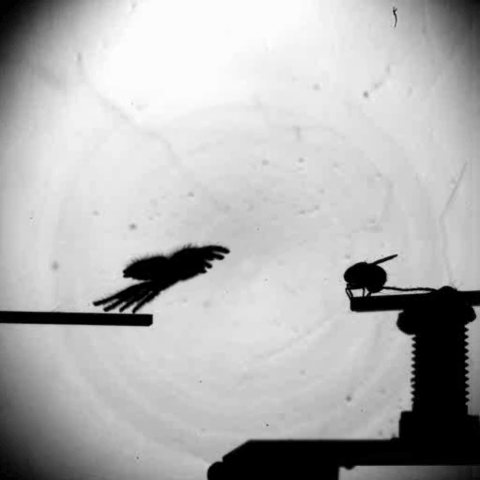
Biological vision: Depth from Defocus
PSF vs object distance
Qi Guo et al., Compact single-shot metalens depth sensors inspired by eyes of jumping spiders, 2019 PNAS 116 (46) 22959-22965
Notes:
To give you some concrete motivation, nature knows very well this idea of computational imaging and the utility of structuring the point-spread function. A famous example is the way that the jumping spider perceives distance when looking at a scene. It is based on optical defocus.
The main eyes of a jumping spider have a point-spread function that is depth-dependent, meaning that it sees its prey with a different amount of blurriness depending on its distance. If it can figure out how blurry an object appears, then this information can be used as an optical cue to tell it how far to jump.
Now actually the vision system is even more interesting than that because the spider’s eyes are designed to capture to two blurry images simultaneous and to compute the difference of the two as a form of triangulation. However, the key detail is that they can compute depth maps of a scene for the lowest computation cost that we know of. This feat of efficiency emerges by co-designing the post-processing algorithm alongside a non-ideal lens.

Slide 5
Features of a Scene: Depth, Spectral Radiance, Polarization
[3] Hyperspectral Depth Dataset From: https://vclab.kaist.ac.kr/iccv2021/dataset.html
Notes:
Speaking of imaging, let’s talk about what makes up the scene that we look at from a physics perspective. The scene is much more than a simple 2D RGB image.
- First, the scene has a dimension of depth, which we alluded to and everyone is already familiar with.

Slide 6
Features of a Scene: Depth, Spectral Radiance, Polarization
[3] Hyperspectral Depth Dataset From: https://vclab.kaist.ac.kr/iccv2021/dataset.html
Notes:
The scene is also characterized by a tensor that we might call the spectral radiance and it underlies the color that we perceive. The spectral radiance describes the fact that white light is a superposition of many independent waves, each with a different wavelength, as can be seen when using a prism. When white light is incident on a surface, each of these waves will reflect with a percentage that depends on what the surface was.
If we sequentially place narrowband spectral filters in front of our lens, we could measure the intensity of the scene at each narrow wavelength channel one-by-one giving us the full spectral radiance cube. We would like to have access to all this data upon measurement.

Slide 7
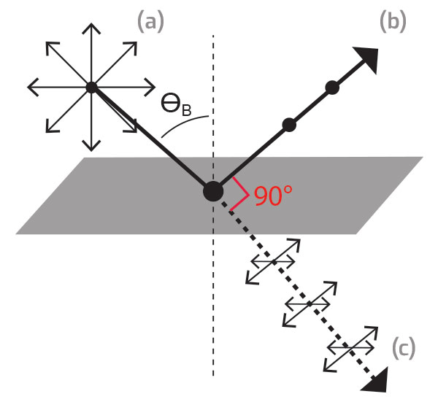
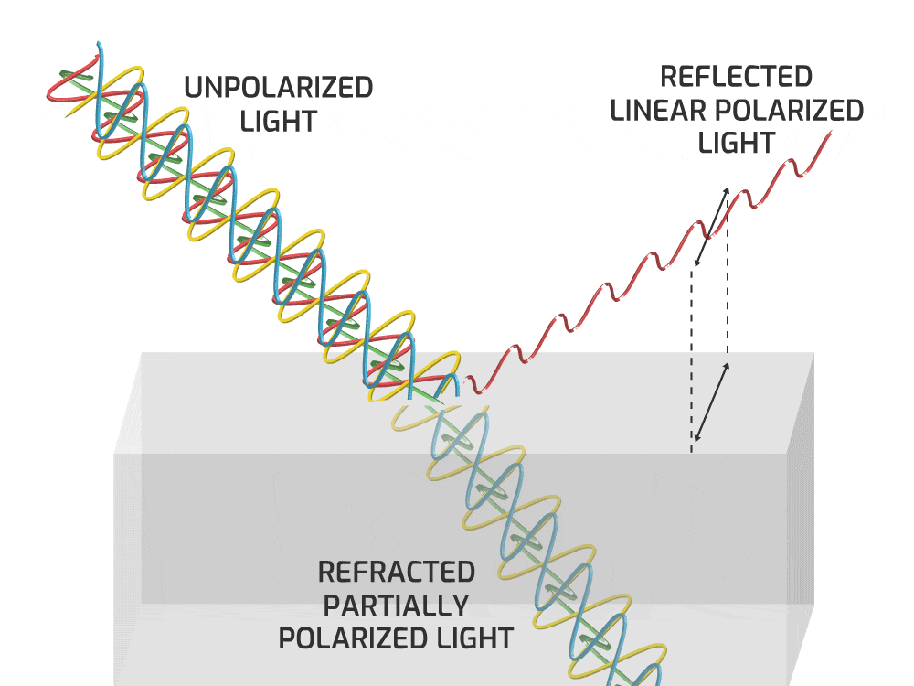
Features of a Scene: Depth, Spectral Radiance, Polarization
(exemplary)
All three features of a scene can in principle be measured in a single snapshot then reconstructed with computational imaging, if they are optically encoded with a specialized lens (feature-dependent point-spread function)
Notes:
Lastly, I want to talk about polarization. Each light wave at each wavelength has its own polarization state, defined as the orientation of the oscillating wave. You might remember learning about Brewsters angle in physics which showed that the scattering or reflection of light differs if the polarization is at an angle normal to the page vs along the page.
A conventional camera with a glass lens is generally not sensitive to the polarization of light (it can’t distinguish different orientations) but again, this data about the scene is extremely useful to have. Similarly, we could put a linear polarizer in front of a lens and rotate it to get the images formed from light at different polarization angles if we had the time.
Instead, all three features of a scene can, in principle, be measured in a single snapshot and then reconstructed with computational imaging if they are optically encoded with a specialized lens. In other words, we need a feature-dependent point-spread function.

Slide 8
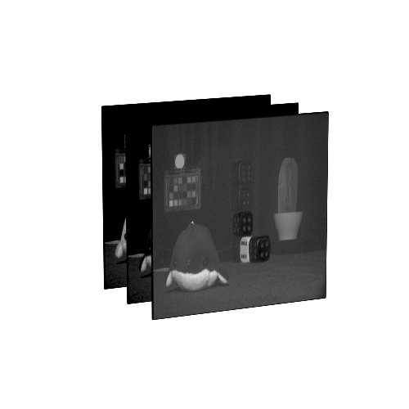
Computational Imaging and Sensing
How can we recover the full information of a scene (or best encode the quantities in the measurement)
Why: We require more than just a 2D spatial map of a scene (ideal image) to interact with the world (e.g. AR/VR)
Material ID/Classification - Segmentation
Depth (3D modeling) - Scientific sensing (wavefront phase, angle of incidence…)
Scene
Render
Measurement
Algorithm
Output
Lens
parameters
Model
parameters
- Seg. Mask
- Depth
- Spectral
Loss
$$∑{\left|Output −Feature\right|}^{2}$$
Gradients
Optical Engineering
Computer Vision
Notes:
Computational imaging and optimization can be applied to answer: how can we recover the full information in a scene (or at least best encode the quantities in the measurement).
And the motivation for doing this is that we require more than just a 2D spatial map of a scene (the ideal image) to interact with the world. We really need a collection of statistics like segmentation maps, material classification and depth. These are all things that we can determine more accurately if we had the spectral radiance and polarization data.
Now let’s talk about the design pipeline:
Suppose you have a scene that is imaged on a camera using a fixed lens. The lens was made by an optical engineer without any special consideration to the downstream task, so by default it is approximately an ideal focusing lens. Given the measurements, it is then the domain of computer vision scientists to train deep neural networks or to derive simpler algorithms for things like predicting spectral radiance, segmentation, or depth sensing and to do so without any specialized optical cues. Unfortunately, these are severely ill-posed problems and they fundamentally can not be solved exactly!

Slide 9
Computational Imaging and Sensing
How can we recover the full information of a scene (or best encode the quantities in the measurement)
Why: We require more than just a 2D spatial map of a scene (ideal image) to interact with the world (e.g. AR/VR)
Material ID/Classification - Segmentation
Depth (3D modeling) - Scientific sensing (wavefront phase, angle of incidence…)
Scene
Render
Measurement
Algorithm
Output
Lens
parameters
Model
parameters
- Seg. Mask
- Depth
- Spectral
Loss
$$∑{\left|Output −Feature\right|}^{2}$$
Gradients
End-to-End Optimization
Render
Lens
parameters
Open-source software (Tensorflow & Pytorch)
Auto-differentiable framework specially geared to co-optimization of flat optics with post-processing networks
D-Flat: A Differentiable Flat-Optics Framework for End-to-End Metasurface Visual Sensor Design, D. Hazineh et al, 2022
Notes:
But better performance and confidence can be achieved by removing this separation of optics and computer vision; Again, nature knows no such distinction when it designs biological vision systems through evolution. What we want to do is an end-to-end optimization of the optic alongside the post-processing algorithm.
The process starts with scene features as the input data, and we must differentiable render the measurement given the current state of the optic. We then treat this measurement as an intermediary tensor in our calculation and pass it on to our learnable algorithm, for example a UNet. The parameters that describe the lens (and thus controls the point-spread function) can be optimized alongside the algorithm weights by standard gradient descent and with auto-differentiation. In this case, we expect and want to get blurry measurements that are optically encoded because we have the backend to decode them.
The project that I am presenting on is a software that we wrote, called D-Flat, to enable this optimization. It solves some underlying challenges inherent to it and ultimately simplifies this procedure. This talk is an overview of what the code itself does and how it handles everything that goes into this box that we call rendering. Ultimately, it lets you co-design a new type of optical technology called a metasurface.

Slide 10
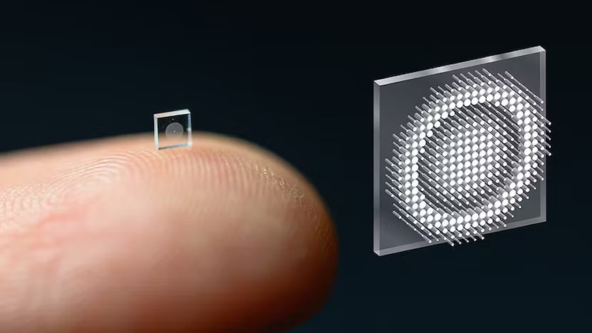
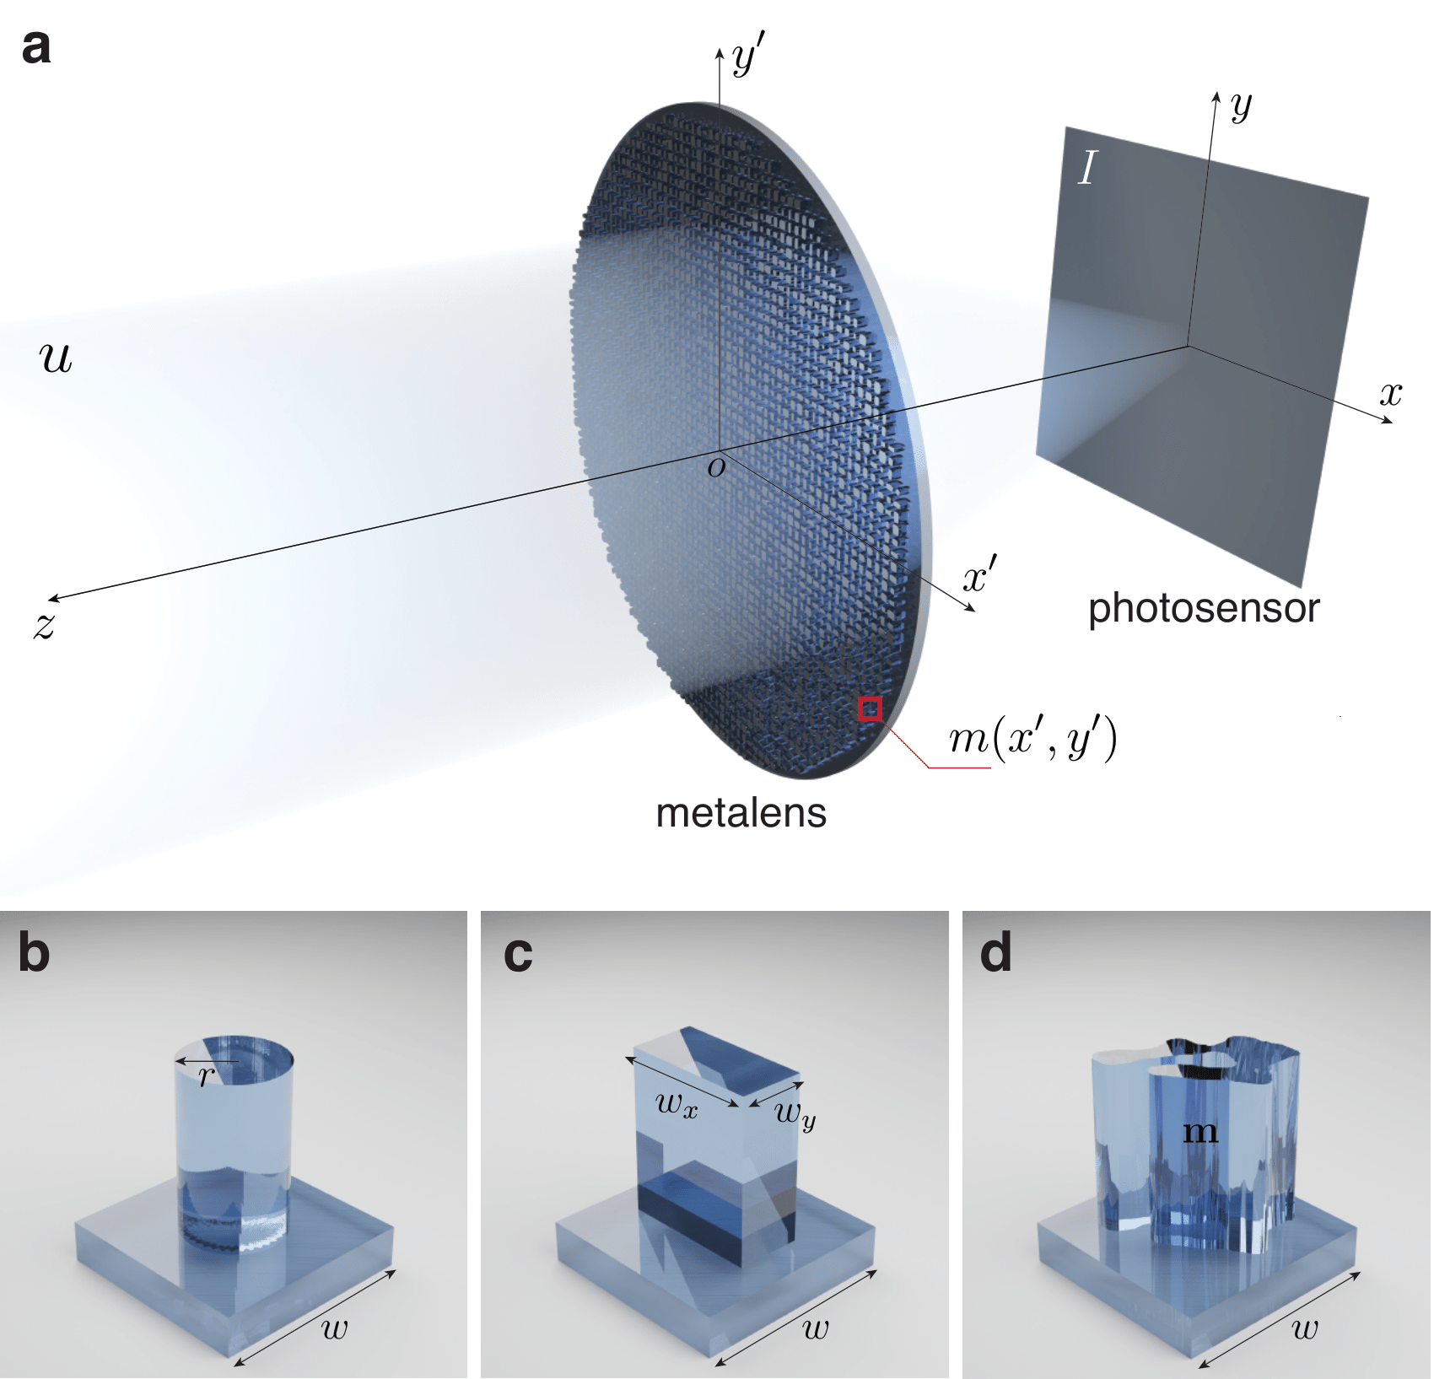
Metasurfaces (Metalens)
(Left) Photo E. Tseng et al., Neural Nano-Optics for High-quality Thin Lens Imaging
Metalenses can transform and structure incident light in ways that other devices cannot!
Polarization, depth, and wavelength dependent point-spread functions
Notes:
Now what are metasurfaces? What I am showing you here are qualitative depictions of metasurfaces and in the next slide, I’ll show you real electron microscope images. Metasurfaces are flat optic lenses and they were pioneered to a large extent here at Harvard. They are made by taking a simple glass substrate and patterning millions of nanoscale shapes on the surface. All these shapes are the same height, which is why we call it a flat optic.
We the designers have the freedom to decide what type of shapes we want to use (for example cylinders, rectangles, or freefrom structures) and how they will vary across the surface. Instead of controlling light by changing the thickness of glass like with a standard lens, we manipulate light by changing the shape at each location.
Importantly, metasurfaces are exactly the type of optic that can produce polarization, depth, and wavelength dependent point-spread functions

Slide 11
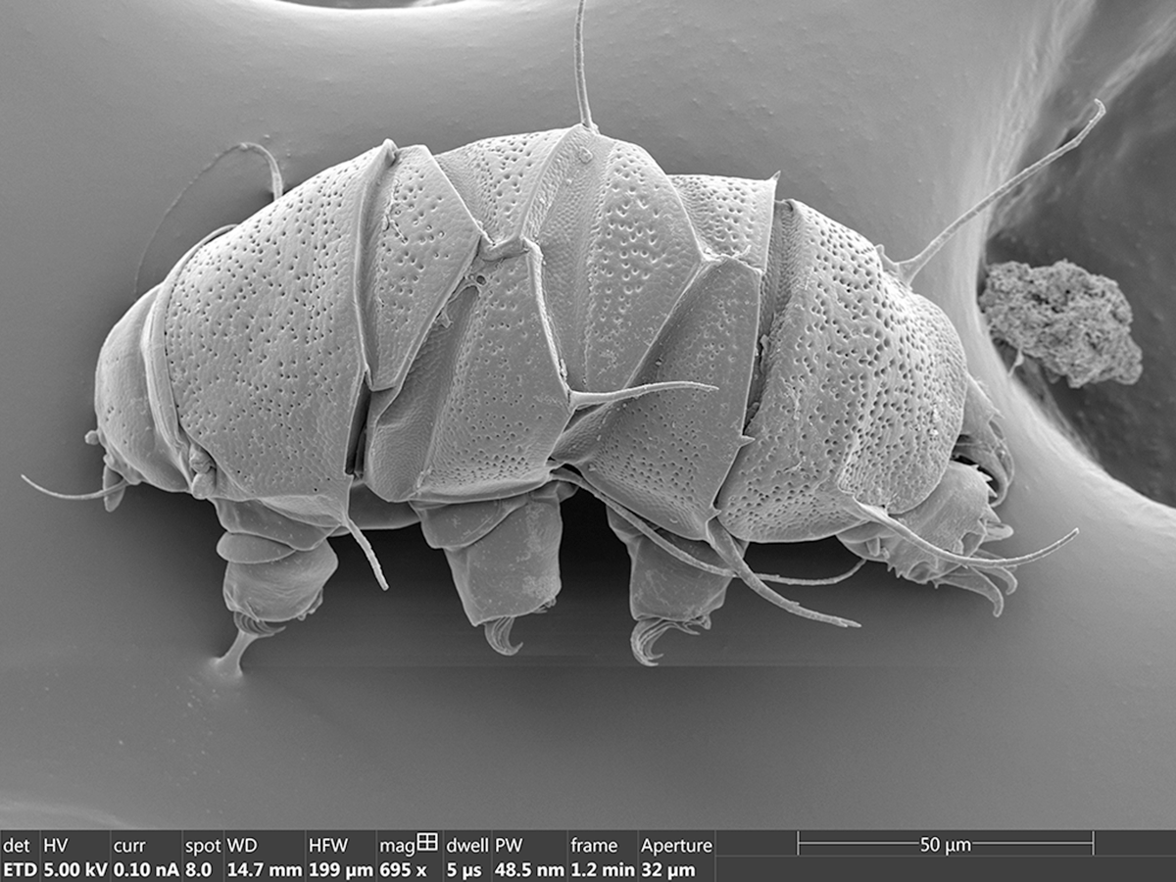
Metasurfaces (Metalens)
2 um
50 um
Metalenses can be millimeters to centimeter scale in diameter but must be modeled at a subwavelength scale (~300 nanometers)
6 um
600 nm
Photo: M. Khorasaninejad et al. (Capasso Group)
Notes:
Again, the structures are too small to see with a light microscope. You have to use an electron beam microscope. For reference, you can see how the shapes we are going to optimize are smaller than even the textures on most micro-organisms like a tardigrade on the right.
One challenge that we have to deal with is the fact that these metalenses can be made with a diameter on the millimeter or centimeter scale but they must be numerically modeled at a subwavelength nm scale, leading to high computational complexity.

Slide 12
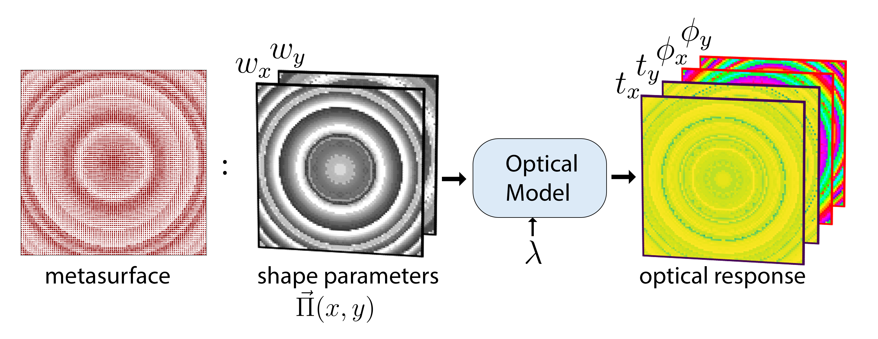
Metasurface Design Theory
Notes:
Let’s talk about how we determine what a metasurface does.
Given a metasurface as a three-dimensional physical structure, we parameterize the optic as a tensor of shape parameters. For example, a pattern of nano-scale rectangles would be defined by a tensor of widths, wx and wy. There then is a function that we refer to as an optical model that prescribes how this collection of shapes transform an incident field of light. The piece that we need to know for imaging is the transmission t and the phase delay phi (for clarity, phase is directly related to the angle that you bend a ray of light). These metasurfaces are strongly wavelength and polarization dependent and so we define this for polarizations, x and y and a wavelength lambda.
The only rigorous optical model that exists for light is Maxwell’s equations. These are a set of four differentiable equations that can only be approximately numerically solved. Unfortunately, it is quickly intractable to solve Maxwell’s equations for the field across the entire device at once so we must introduce an approximation.

Slide 13
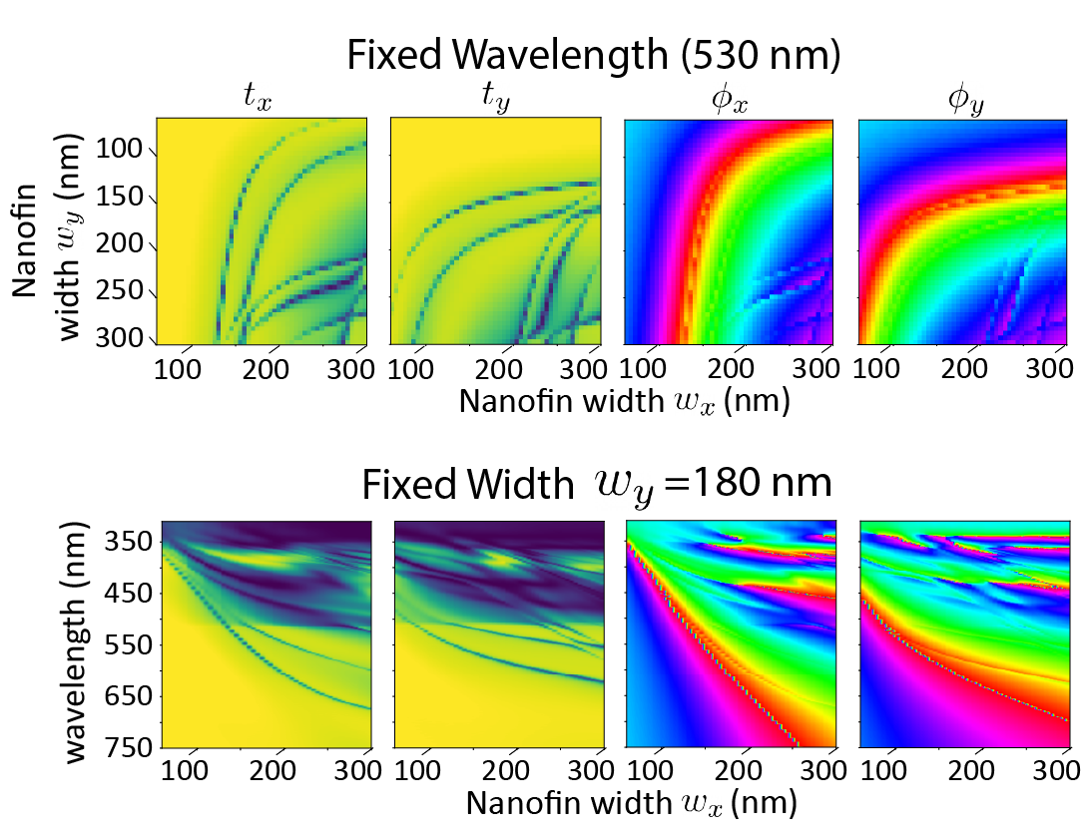
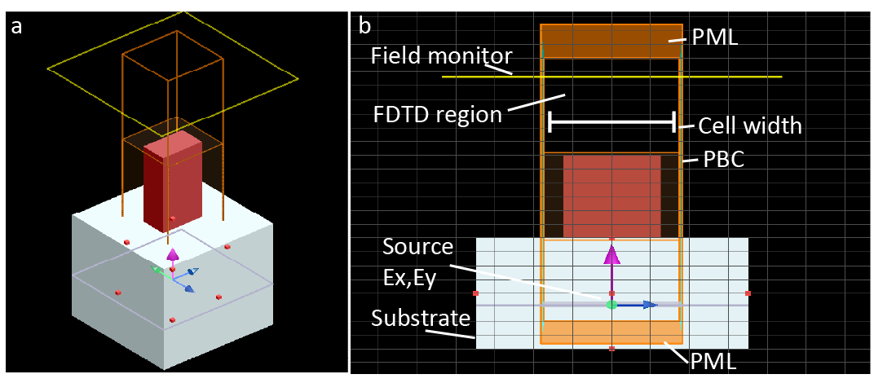
Metasurface Design Theory
→ (approximation) Meta-atom as building blocks
→ Build dataset by sweeping & solving Maxwell’s Equations
Notes:
That is the idea of a meta-atom as a building block. We break up the device into the smallest unit, usually a block that only holds a single shape, and we solve Maxwell’s equations to get the optical response for that block. We then build up a dataset by sweeping all instantiations of that shape.
This shown on the right. For a single wavelength, we can sweep the width of the nanofin along x and y and see the changes in the transmission and phase. And below, we can keep one width fixed and sweep the wavelength to see how the response of that nanofin changes with different wavelengths of light.

Slide 14
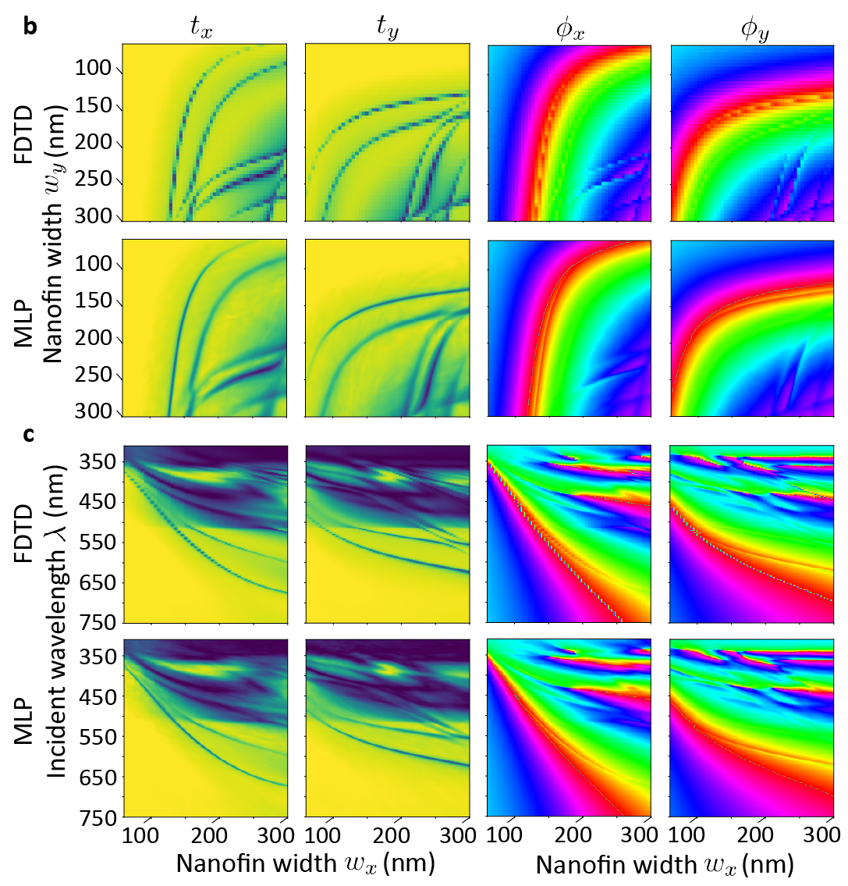
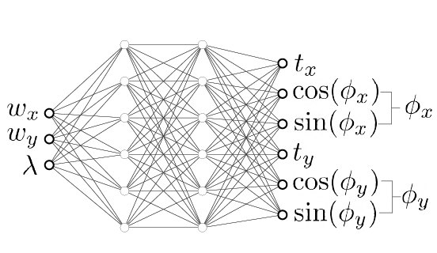
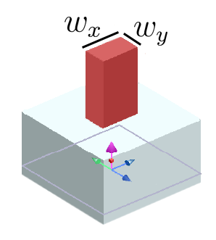
Auto-Differentiable Optical Model
Auto-differentiable field solver (RCWA, FDFD)
Neural Representation
MLP requires a factor of at least x${10}^{5}$ fewer FLOPS per cell evaluation
vs our auto-differentiable field solver
Notes:
Having a pre-computed dataset however is not yet good enough. For our co-optimization task that is based on gradient descent, we need an auto-differentiable optical model. And there are two options, both of which we have worked on.
The first is to use an auto-differentiable field solver. You simply code your numerical solver in pytorch or tensorflow so when you do the forward calculations for a small piece of the lens, you get the gradients of the shape too. This is still too expensive for computational imaging, so we wont talk about it more today. The solution that we do use more often are neural representations.
It ends up that you can train a simple MLP (a multi-layer perceptron) to learn the optical mapping for a given dataset. We found that even with a small two-layer MLP (in other words just a vanilla neural network), you can reproduce the pre-computed mapping with very little error as shown in the middle. Once trained, you can freeze the weights of this network and you now have an auto-differentiable, cheep function that requires a factor of 10^5 to 10^7 fewer FLOPs per evaluation.

Slide 15
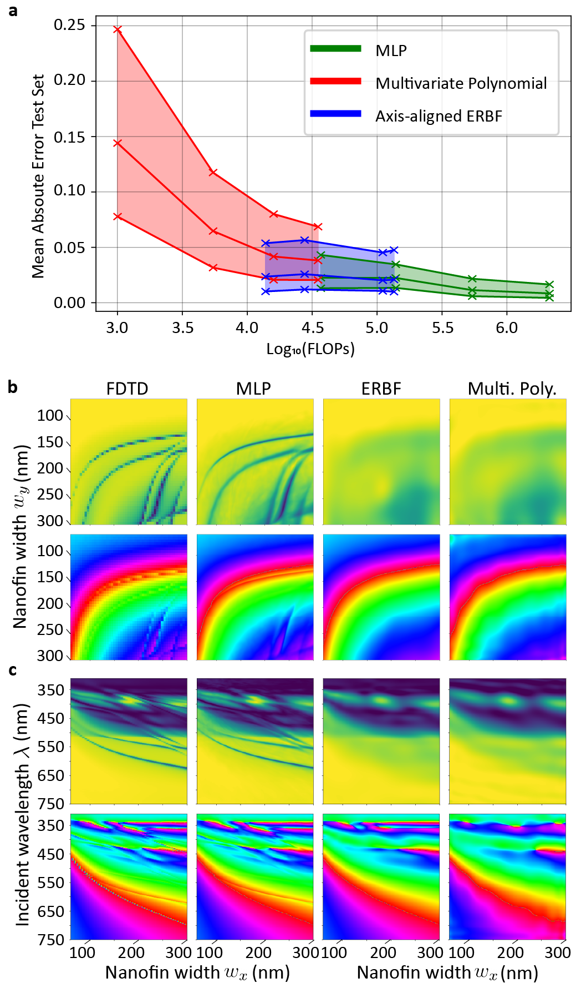
Auto-Differentiable Optical Model
Auto-differentiable field solver (RCWA, FDFD)
Neural Representation
MLP requires a factor of at least x${10}^{5}$ fewer FLOPS per cell evaluation
vs our auto-differentiable field solver
Notes:
As a brief note, we looked at other simple approximate functions. We trained an elliptic radial basis function network and also tried to fit multivariable polynomial functions to the dataset. You can see on the right that for the nano-rectangle (and really anything more complicated than a rectangle) the other methods failed to capture all the features of the dataset.

Slide 16
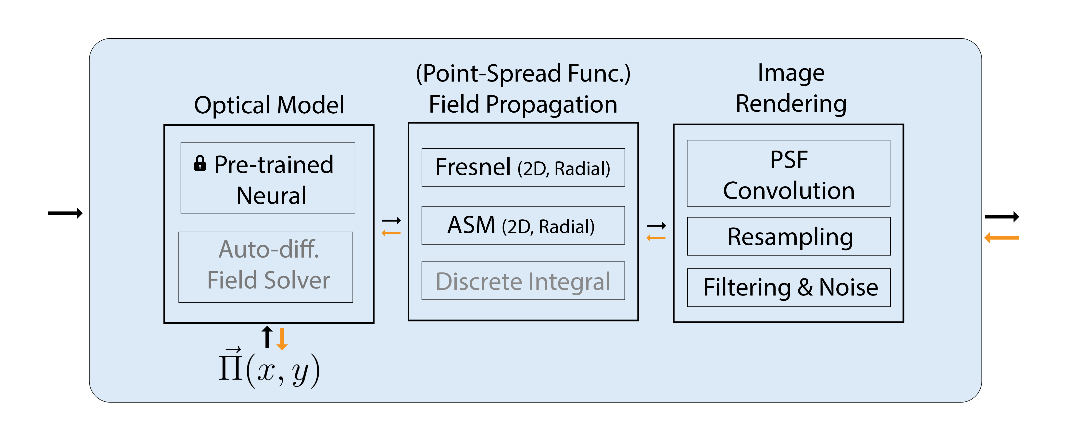
Auto-Differentiable Optical Model
Scene
Render
Measurement
Lens
parameters
Notes:
Now I can really start to fill out in more detail what Dflat does to make co-optimization possible. Specifically, the sequence of calculations that must go into this rendering block.
We start by having or initializing a metasurface shape tensor. It is a learnable parameter just like the weights in a neural network block, but here, it corresponds to something very physical.
We then use a pre-trained neural network to solve for the optical response quickly and efficiently. And after, we then compute the point-spread function by a process known as field propagation which I will talk about more. Lastly, with the point-spread function, we can simulate the measurement that we would get on a photosensor.

Slide 17
Auto-Differentiable Optical Model
Code designed for versatility and scale (One of the key value propositions of DFlat):
Manage large collection of meta-atom datasets
Every shape type, material, block size, requires a new pre-computed dataset
Query a dataset by name and automatically download it from server
Datasets have a standard form (class) speeding up integration to ML pipeline
Integrated field solver to generate new datasets
Notes:
I want to highlight now why we found it convincing to write this software for the community. While time and energy was initially spent on the physics, a lot of time later went into the software architecture side to think about how to make this type of package versatile and scalable.
Specifically, this method implies that we will end up having to manage a very large collection of datasets and pre-trained models.
Consider that for every shape type (a rectangle vs an ellipse), material type, structure height, block size, etc, we need to recompute a new dataset. This means that we will quickly accumulate dozens of different meta-atom libraries.
- The way that we handle this is by creating a code where you can query a dataset by name and it is automatically downloaded from a server. The datasets all have standardized form to speed up integration into machine learning pipelines… There is also a field solver code that one can use to make new datasets.

Slide 18
Auto-Differentiable Optical Model
Code designed for versatility and scale (One of the key value propositions of DFlat):
Manage large collection of meta-atom datasets
Every shape type, material, block size, requires a new pre-computed dataset
Query a dataset by name and automatically download it from server
Datasets have a standard form (class) speeding up integration to ML pipeline
Integrated field solver to generate new datasets
Manage large collection of pretrained neural networks
MLPs will have different input-output dimensions (for different meta-atoms)
Different architectures (ex. number layers, attention, etc.)
Different pre-processing steps and normalization terms (min/max shapes)
Pre-trained models called by name and model weights/configuration files are downloaded from server
Models are assembled on the fly according to the configuration file
Inherit standardized class/parent so user functionality is the same regardless of the meta-atom/dataset choice
Notes:
Now for every dataset, you can also expect to have several pre-trained models. What makes this challenging is that every MLP can have a different number of input-output dimensions, different architecture designs, and more importantly, a different set of pre-processing steps.
- The way that we handle this is, again by creating a code where pre-trained models can be called by name and then the weights and configuration files are downloaded from a server. The models are then assembled on the fly according to the configuration file so they can have any type of architecture. Importantly, the model you get handed has a standardized class architecture so the user functionality is the same regardless of which shape you are working with.

Slide 19
Auto-Differentiable Optical Model
Notes:
And I can show you briefly how part of that looks like in practice.
You import the dflat metasurface module
You call for a pre-trained model by name. After which it is loaded and assembled.
And then you can just pass it your shapes and wavelengths and get back the optical response.
You can also use the code for a reverse look-up. You can give it a target phase, transmission, and specify the model name (in this case it is different than the one above), and it will return to you the shapes that best implement it.

Slide 20
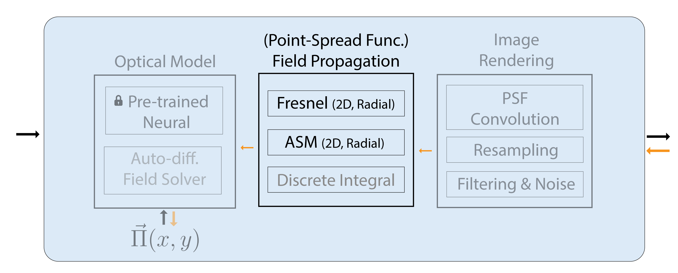
Auto-Differentiable Field Propagation
Notes:
Now, the next piece that we need in our optimization framework is field propagation. Given the phase and transmission on the metasurface, obtained by our optical model, the point-spread function is computed by propagating the field forward to the sensor. Before we talk about it more, let me show you what that looks like in practice. Starting with the transmission and phase at the lens plane of our camera, we can move our photosensor back and simulate how the light field evolves in space – This output is obtained by a theory called Fourier Optics and by computing a double integral.

Slide 21
Auto-Differentiable Field Propagation
Different numerical implementations of field propagation:
Fresnel Method: x1 Fourier/Hankel transform (approximate)
Angular Spectral Method: x2 Fourier/Hankel transforms (exact)
Discrete Integration: Pixel space transformation (exp., exact)
Desirable implementation involves many steps (method dependent)
Up-sample user provided profile according to few conditions
Zero-padding determines output field discretization ($λ, z)$-dependent
Resample output field to a pixel size grid if sub-pixel sampling
→ There are many scenarios where one method is more efficient than the other
Operation in computational imaging research that we wanted to standardized and provide for others
Notes:
Our package implements the calculations in pytorch and tensorflow so that we can use auto-differentiation, but there is more to the story. Specifically, there are few different ways that you can numerically solve the propagation equation and I tried to account for all of them. There is an approximate solution to the integral called the Fresnel method which involves a single 2D Fourier transform. If you have radially symmetry, however, you can speed up they calculation by using Hankel transforms instead. The hankel transform is not a built-in function of any auto-differentiable package so I coded it myself. There is also the Angular spectral method, in 2D or radial form, that we have worked out which is an exact solution but requires twice the number of transforms.
A good code to do field propagation for either method also has a fair number of hidden steps besides just solving an integral. The steps are different for each method but it generally includes upsampling in certain scenarios, zero-padding with an amount that is wavelength and distance dependent, and resampling the output fields.
In the end, it is also necessary to have these variations because there are many scenarios where one method is more accurate or computationally efficient. You can easily find scenarios where one of these forms is intractable while the other is not!
Ultimately, this was something that we thought could be standardized

Slide 22
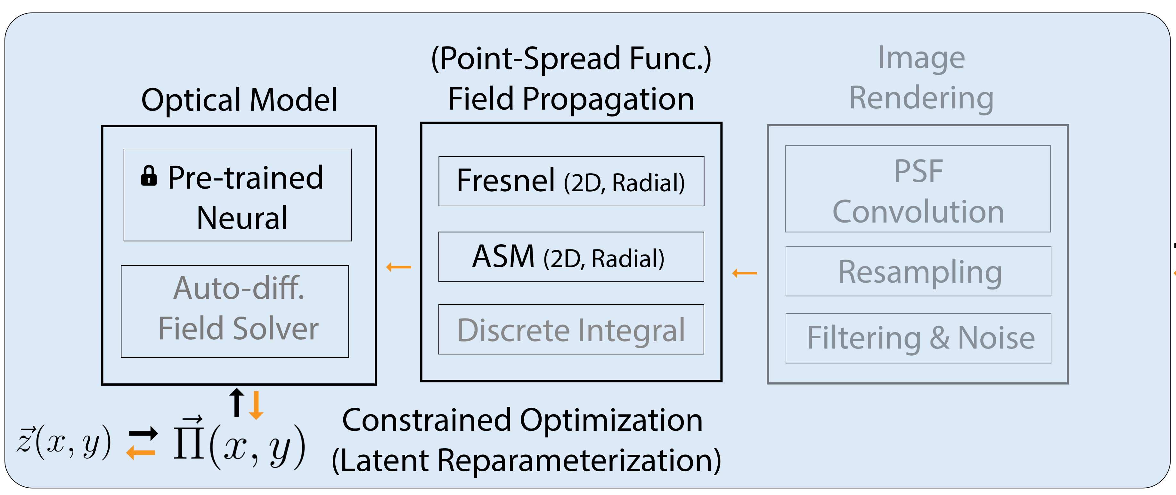
Point-Spread Function Optimization
Optimize the shapes on a metasurface to produces a simple multi-focci point-spread function at the sensor plane
→ Exists analytic solution for the ideal phase and transmission profile to produce each focal lobe alone but not obvious how to optimally merge the many behaviors into one lens.
50 um
6 um
600 nm
Notes:
Now I want to pull these pieces together and show you in a demo what it looks like to optimize a metasurface. We will initialize a shape tensor, use a frozen MLP as our optical model, and then differentiably propagate the fields to get the PSF. We can then update the shapes through gradient descent.
Specifically, this demo optimizes the shapes on the metasurface to produce a multi-focci point-spread function at the sensor plane. Interestingly, there exists analytic solutions for the necessary phase and transmission for each lobe alone but its not obvious how to merge the three into one lens.
The evolution of the lens during the process is shown below.

Slide 23
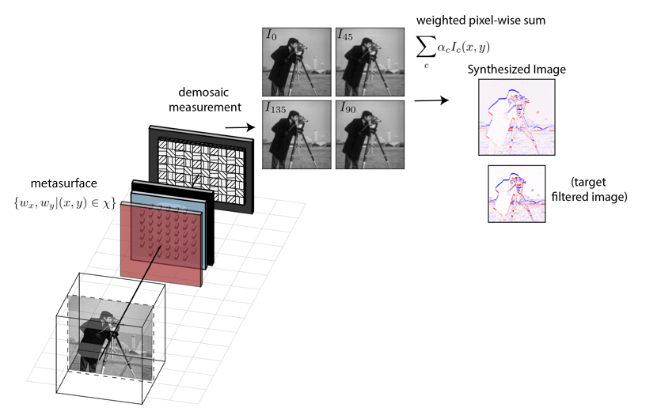
Task-Specialized Vision: Optical Computing
Replace digital image processing (e.g. edge-detection) with cheaper opto-electronic operations
(More info)
Notes:
Why does this matter? The goal of this project is to enhance the union of optics and computer vision and to enables devices that we might call task-specialized vision systems. An example was the depth sensor at the start but one more example that we worked on is optical computing.
By having the right optics, you can replace purely digital image processing (for example edge detection) with a cheaper opto-electronic version. In other words, part of your calculation is done for free by light.
Here, we wanted to use a metasurface to create measurements of our scene with different blurs for different polarization states of light. A set of four optically coded images could then be obtained at once using a polarizer-mosaiced photosensor. We then would just linearly add or subtract these images with certain weights to get back a differentiated image for only seven FLOPs. This is orders of magnitude fewer FLOPs than the equivalent digital operation.

Slide 24
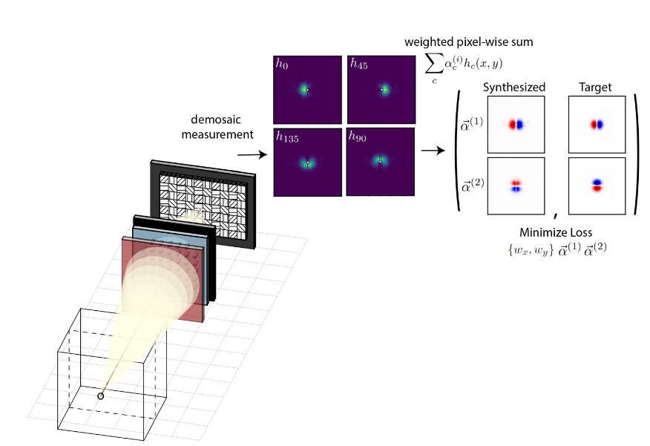
Task-Specialized Vision: Optical Computing
Replace digital image processing (e.g. edge-detection) with cheaper opto-electronic operations
(More info)
Steerable gaussian derivative by changing the digital summation weights
→ First time that opto-electronic processing this was done in a single snapshot with a single sensor
Notes:
This task is exactly point-spread function optimization like I showed you on the last slide. It can be rigorously formulated as optimizing our point-spread function to be polarization dependent and to encode different halves of a gaussian function on different polarization states. When you do this, you are guaranteed to have many linear combinations of the images that will correspond to the derivative along different directions! This was the first time that opto-electronic processing this was done in a single snapshot with a single sensor and we used Dflat for this.

Slide 25
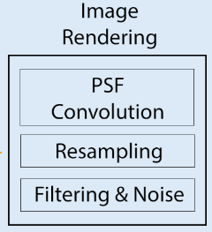
Point-Spread Function Optimization
Dflat Goal: Make the optimization of flat optics as easy as optimizing a deep neural network (code perspective)
Using pre-trained metasurface models should be as easy as using a pre-trained CLIP or Perceptual Loss
Challenge: Each metasurface model is like a CLIP trained in a different language (different tokenizers, datasets…)
Modules for point-spread functions/propagations should be as easy as using Conv2D layer
Challenge: Managing large number of branches in code for different approximations and configurations
Additional piece not discussed as much in this talk:
Notes:
To wrap things up, a goal in writing Dflat was to make the optimization of flat optics as easy as optimizing deep neural networks (from a coding perspective)
What that means is that:
Using the pre-trained metasurface models should be as easy as using a pre-trained CLIP or perceptual loss. If you haven’t heard of those, basically those are frozen neural networks that you might use in your loss function for various machine learning tasks. The challenge was that each metasurface model is kind of like a CLIP trained in a different language.
And using the modules for field propagation should be as easy using a standard Conv2D layer in pytorch. The challenge here was managing a large number of branches in the code for different conditions, configurations, approximations and not losing out on efficiency for different scenarios.
The end result looks something like this: This video summarizes how you could do all the point-spread function optimizations I showed you in a relatively few lines of code.
We initialize the field propagation module with basic things like the desired output field discretization, size, radial symmetry acceleration, and calculation method.
We also load a pre-trained optical model as done before
The body of an optimization loop would look like this:
Initialize a trainable tensor for the shapes
Pass it through the optical model
Pass the output to the PSF model and get back the intensity and phase on the sensor
Write an L1 or L2 loss function between the intensity you have and the target intensity
And then simply call for the gradients

Slide 26
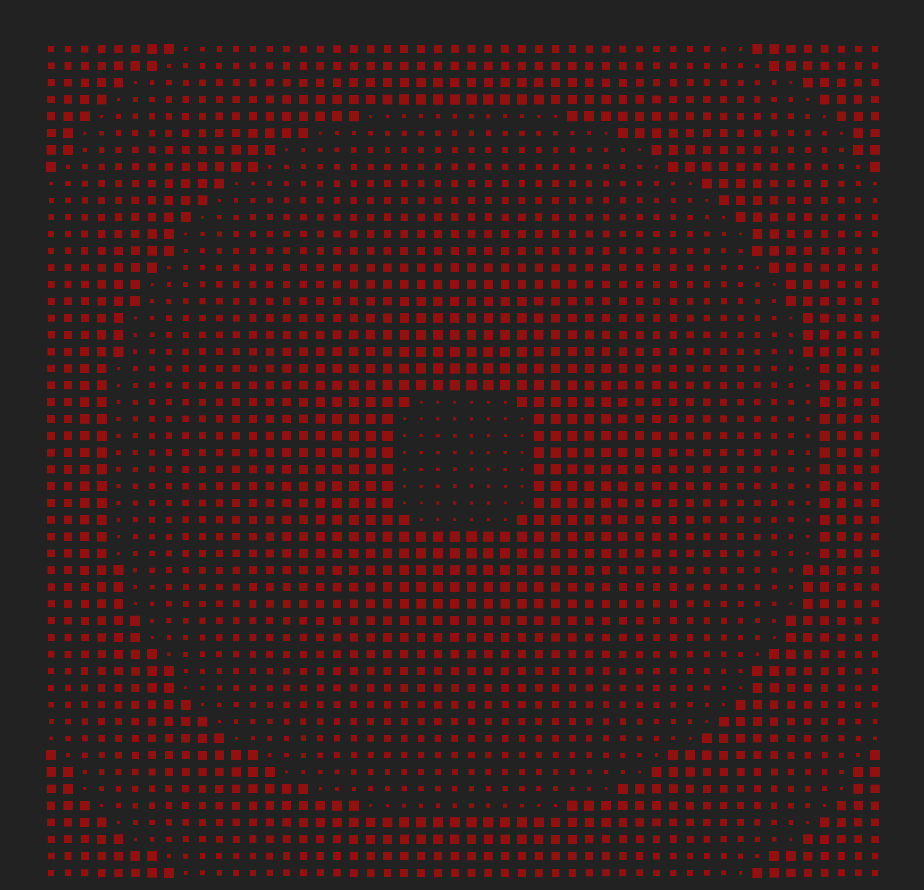
Free and Open Source:
Continuous Integration / Pytest Workflow
Complete docstrings (missing new readthedocs)
Available on Python Package Index (PyPi) as “dflat_opt”
Nightly versions on Github
(Github)
A lot of open computational projects for all skill levels: (email @ dhazineh@g.harvard.edu or give it a try)
(Contact Todd Zickler for CS / Federico Capasso on Fabrication)
Differentiable field solvers
Large area topology optimization for high-dimensional shapes
*Memory efficient propagation (bottleneck)
Co-Optimization with CNNs
Rendering without shift-invariant PSF assumption
Gradient checkpointing and other code improvements
Notes:
Thank you for your attention. I will highlight that this code package has a lot of the standard feature you would expect:
It has continuous integration and a pytest workflow on github. That means that if somone pushes an update that breaks the tests, the push will be rejected.
It has complete docstrings although we no longer have a readthedocs page
The code is available on the Python package index, meaning it can be installed by calling pip install dflat_opt
And I maintain the source on github
I will leave this up here but there are also a lot of interesting and open problems related to this talk for people of all skill levels.

Slide 27
Extra

Slide 28
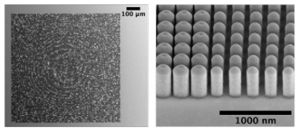
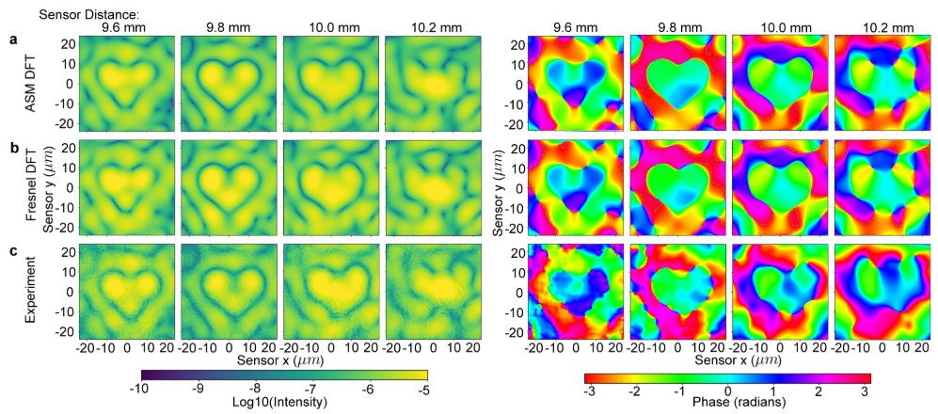
Auto-Differentiable Field Propagation
Validation of implementations against experiment
Different numerical implementations of field propagation:
Fresnel Method: x1 Fourier/Hankel transform (approximate)
Angular Spectral Method: x2 Fourier/Hankel transforms (exact)
Experimental data from Dr. Daniel Lim, Capasso Group
2 um
50 um
6 um
600 nm
Notes:
I won’t spend too long on this but we made efforts to validate the calculations and to ensure that the code is correct.
For example, we fabricated a metalens as shown on the right and experimentally took measurements of both the intensity and phase of the field after propagating different distances. This is shown on the bottom row. The main point is that we found good agreement between our code implementations and experiment for this and other tests.

